Slide 1
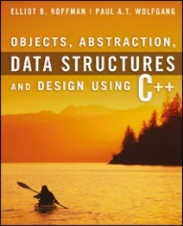
Welcome to
CS 235 Data Structures
C++ Primer, P.4-6 (04)

Slide 2
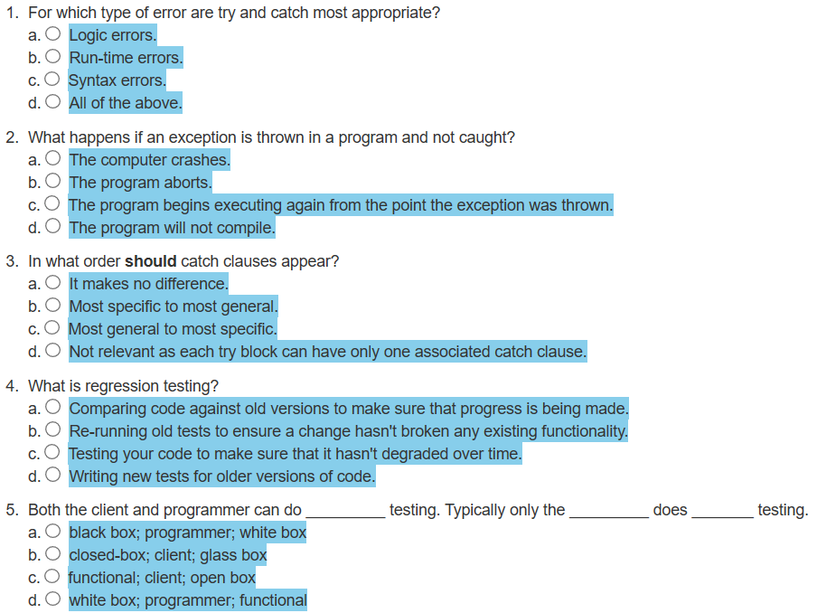
Attendance Quiz #07

Slide 3
Tip #08: File or Console
#include <iostream>
#include <fstream>
#include <string>
using namespace std;
int main(int argc, char* argv[])
{
if (argc < 2) return 1;
ifstream in(argv[1]);
if (!in) return 2;
ostream& out = (argc > 2) ? *(new ofstream(argv[2])) : cout;
if (!out) return 3;
string line;
while (getline(in, line))
{
out << line << endl;
}
if (&out != &cout) delete(&out);
in.close();
return 0;
}
Dereference pointer returned from new so that out can reference the ofstream object.
Must have at least one argument. Open for input (check for error).
Use cout if no output file is specified (argv[2]).
Read a line from input file.
Output line to file (or cout.)
Delete input stream object.
(delete needs a pointer)
No Memory Leaks!

Slide 4
Testing Programs
Even after all syntax and run-time errors are removed and a program executes through to normal completion, there is a possibly that undetected logic errors exist.
The "best" kind of logic error is one that occurs in an area of the program that always runs.
The "worst" kind of logic error is in an obscure part of the code that is executed infrequently.
Testing Techniques:
Structured walkthroughs.
Testing at various levels.
Blackbox / whitebox testing.
Test boundary conditions.
Regression testing.

Slide 5
Regression Testing
Regression testing is re-running functional and non-functional tests to ensure that previously developed and tested software still performs after a change.
Bug fixes
Software enhancements
Configuration changes
Electronic component changes.
As software is updated or changed, or reused on a modified target, emergence of old/new faults is quite common.
A fix gets lost through poor revision control practices.
A fix for a problem will be "fragile" - narrow vs. general case.
A fix in one area inadvertently causes a software bug in another area.
Some feature redesign makes the same mistakes that were made in the original implementation of the feature.
It is considered good coding practice, when a bug is located and fixed, to record a test that exposes the bug and re-run that test regularly after subsequent changes to the program.

Slide 6
Tips for Testing Classes
If the function implements an interface, the interface specification should document the input parameters and the expected results.
Document each function parameter and class attribute carefully, using comments as you write the code.
Leave a trace of execution by displaying the function name as you enter it.
Display the values of all input parameters upon entry to a function. Also display the values of any class attributes that are accessed by this function; check that these values make sense.
Display the values of all function outputs after returning from a function.
By hand computation, verify that these values are correct.

Slide 7
2.4 Debugging a Program
Using a Debugger
2.4, pgs. 160-165

Slide 8
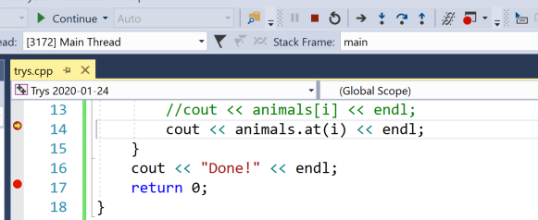
Symbolic Debugging
Single-step execution involves
Executing a statement in increments as small as one program statement
Examining the contents of variables at each step.
Setting breakpoints allows us to divide programs into sections.
The debugger executes until it encounters a breakpoint.
When our program pauses, if the next statement is a call to a function, we can select single-step execution in the function, called step into.
Or we can execute all the function statements as a group and pause after the return from the function, called step over.
Step Into (F11)
Step Over (F10)
Step Out
(Shift F11)

Slide 9
Exception Handling
#include <iostream>
#include <vector>
#include <string>
using namespace std;
int main(int argc, char* argv[])
{
vector<string> animals = { "dog", "cat", "horse" };
for (int i = 0; i < 4; i++)
{
cout << "animals[" << i << "] = ";
//cout << animals[i] << endl;
cout << animals.at(i) << endl;
}
cout << "Done!" << endl;
return 0;
}
#include <stdexcept>
try
{
}
vector will throw and "out-of-range" exception.
Protect code with a try/catch.
// catch std::out-ot-range exception that derives from std::exception
catch (const out_of_range& oor) { cerr << oor.what() << endl; }
// catch anything thrown within try block that derives from std::exception
catch (const exception& e) { cerr << e.what() << endl; }
// catch all exceptions
catch (...) { cerr << "???" << endl; }

Slide 10
2.5 Reasoning about Programs: Assertions and Loop Invariants
Assertions
Loop Invariants
The C++ assert Macro
2.5, pgs. 166-168

Slide 11
Assertions
Assertions are logical statements about a program condition that are "asserted" to be true.
A pre-condition is an assertion about the state of the input data (generally the input parameters) before the function is executed.
For example, a pre-condition for method double divide(double dividend, double divisor) might be divisor != 0.
A post-condition is an assertion about the state of the output data when the function returns.
For example, a post-condition for method int search (int x[], int x_length, int target) would be all elements were tested and target not found.
An invariant is a particular pre-condition of a procedure that is the same (hasn't changed) after the procedure is completed.
For example, a valid invariant for a procedure boolean search(int term, int array[]) might be that the state of array before the call is the same as it is after the call.

Slide 12
2.6 Efficiency of Algorithms
Big-O Notation
Comparing Performance
Algorithms with Exponential and Factorial Growth Rates
2.6, pgs. 170-179

Slide 13
Efficiency of Algorithms
Getting a precise measure of the performance of an algorithm is difficult.
We can try to approximate the effect of a change in the number of data items, n, that an algorithm processes.
In this way we can see how an algorithm's execution time increases with respect to n, so we can compare two algorithms by examining their growth rate.
For many problems there are algorithms that are relatively obvious but inefficient.
Even though computers are getting faster, with larger memories, algorithm growth rates can be so large that no computer can solve the problem above a certain size.

Slide 14
Big-O Notation
Consider the following functions with respect to execution:
1 time
int i = sqrt(n);

Slide 15
Big-O Notation
Consider the following functions with respect to execution:
1 time
int i = sqrt(n);
n times
for (int i = 0; i < n; ++i)
{
// Statement(s)
}

Slide 16
Big-O Notation
Consider the following functions with respect to execution:
1 time
int i = sqrt(n);
n times
for (int i = 0; i < n; ++i)
{
for (int j = 0; j < m; ++j)
{
// Statement(s)
}
}
(n × m) times

Slide 17
Big-O Notation
Consider the following functions with respect to execution:
1 time
int i = sqrt(n);
n times
for (int i = 0; i < n; ++i)
{
for (int j = 0; j < n; ++j)
{
// Statement(s)
}
}
(n × m) times
(n × n) times

Slide 18
Big-O Notation
Consider the following functions with respect to execution:
1 time
int i = sqrt(n);
n times
for (int i = 0; i < n; ++i)
{
for (int j = i; j < n; ++j)
{
// Statement(s)
}
}
(n × m) times
(n × n) times
(n × (n / 2)) times

Slide 19
Big-O Notation
Consider the following functions with respect to execution:
1 time
int i = sqrt(n);
n times
for (int i = 0; i < n; ++i)
{
for (int j = 1; j <= n; j *= 2)
{
// Statement(s)
}
}
(n × m) times
(n × n) times
(n × (n / 2)) times
(n × log₂ n) times

Slide 20
Big-O Notation
Consider the following functions with respect to execution:
1 time
int i = sqrt(n);
n times
for (int i = 0; i < n; ++i)
{
for (int j = 0; j < n; ++j)
{
for (int k = 0; k < n; ++k)
{
// Statement(s)
}
}
}
(n × m) times
(n × n) times
(n × (n / 2)) times
(n × log₂ n) times
(n × n × n) times

Slide 21
Big-O Notation
Understanding how the execution time (and memory requirements) of an algorithm grows as a function of increasing input size gives programmers a tool for comparing various algorithms and determining how they will perform.
If the execution time stays the same regardless of the number of inputs, then the growth rate is constant or of order 1.
If the execution time approximately doubles when the number of inputs, n, doubles, then the algorithm grows at a linear rate or a growth rate of order n.
If the execution time is approximately quadrupled when the number of inputs is doubled, then the algorithm grows at a quadratic rate or at a growth rate of order of n^{2.}

Slide 22
Big-O Notation
The previous examples illustrate execution growth rates:
1 time
n times
(n × m) times
(n²) times, (n × (n / 2)) times
(n log n) times.
Computer scientists use the notation
O(1) to represent the first case (constant time)
O(n) to represent the second case (linear time)
O(n × m) to represent the third case (quadratic time)
O(n²) to represent the fourth (quadratic time)
O(n log n) to represent the fifth case (logarithmic time)
The symbol O can be thought of as an abbreviation for “order of magnitude” and is called big-O notation.

Slide 23
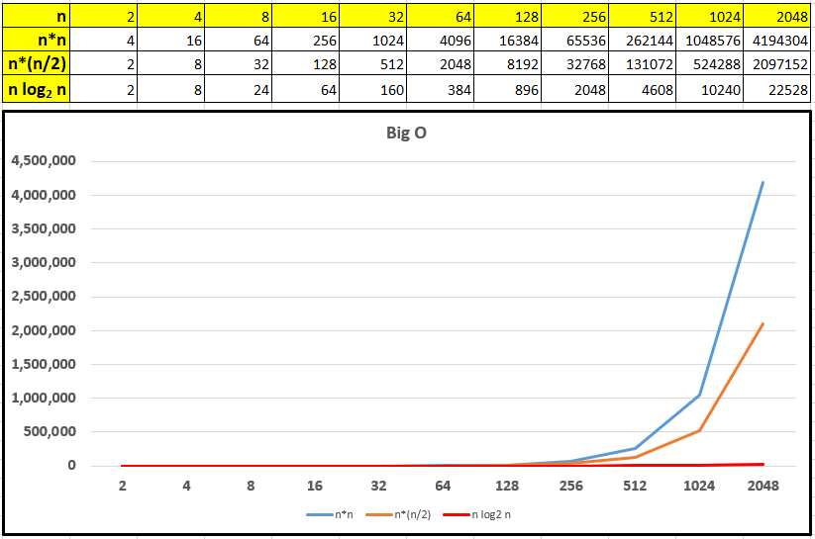
Big-O Notation

Slide 24
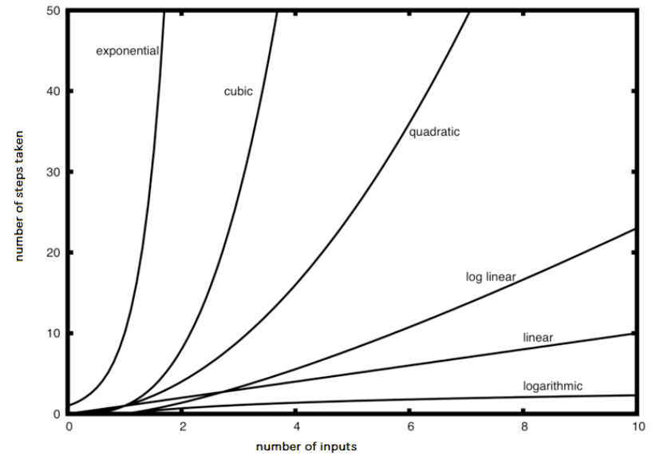

Slide 25
Big-O Notation
A simple way to determine the big-O of an algorithm or program is to look at any loops and to see whether the loops are nested.
Assuming that the loop body consists only of simple statements,
a single loop is O(n)
a nested loop is O(n²)
a nested loop in a nested loop is O(n³), and so on
The growth rate of f(n) will be determined by the fastest growing term, which is the one with the largest exponent.
In general, it is safe to ignore all constants and to drop the lower-order terms when determining the order of magnitude.

Slide 26
Big-O Example
void T(int n)
{
for(int i = 0; i < n; ++i)
{
for(int j = 0; j < n; ++j)
{
// Simple Statement;
}
}
for(int j = 0; j < n; ++j)
{
// Simple Statement 1;
// Simple Statement 2;
// Simple Statement 3;
}
// Simple Statement 1;
// ...
// Simple Statement 8;
// Simple Statement 9;
}
The outer loop will execute n times. The inner loop will execute n times for each outer loop iteration. (n²)
We can conclude that the relationship between processing time and n (the number of Simple Statements processed) is:
T(n) = n² + 3n + 9
The growth rate of f(n) will be determined by the fastest growing term, which is the one with the largest exponent. In the example, an algorithm of O(n² + 3n + 9) is more simply expressed as O(n²).
The loop will execute 3 Simple Statements n times. (3n)
Finally, 9 Simple Statements are executed. (9)

Slide 27
Growth Rate
The growth rate of f(n) will be determined by the fastest growing term, which is the one with the largest exponent.
An algorithm of O(n² + 3n + 9) complexity is more simply expressed as O(n²).
In general, it is safe to ignore all constants and to drop the lower-order terms when determining the order of magnitude.
Basic Rules:
Nested loops are multiplied together.
Sequential loops are added.
Only the largest term is kept, all others are dropped.
Constants are dropped.
Conditional checks are constant (i.e. 1).

Slide 28
Formal Definition of Big-O
An algorithm of
O(n² + 3n + 9)
is more simply expressed as
O(n²)
3 × n²
For c = 3 and n > n₀
c × T(n) >= f(n)
n² + 3n + 9

Slide 29
What is the Big-O of the following:
// #1
for (int i = 0; i < n; ++i)
{
cout << i << endl;
}
// #5
for (int i = 0; i < size; ++i)
{
cout << arr[i] << endl;
}
for (int i = 0; i < size; ++i)
{
cout << arr[i] << endl;
}
O(n)
O(n)
// #2
{
cout << i << endl;
}
O(1)
// #3
for (int i = 0; i < n + 1; ++i)
{
for (int j = 1; j < n; j *= 2)
{
//do swap stuff, constant time
}
}
// #6
for (int i = 0; i < size; ++i)
{
cout << a[i] << endl;
}
for (int i = 0; i < size; ++i)
{
for (int j = 0; j < size; ++j)
{
cout << a[i] + a[j] << endl;
}
}
O(n²)
O(n log n)
// #4
int fib(int num)
{
if (num <= 1) return num;
return fib(num - 2) + fib(num - 1);
}
O(2^{n})

Slide 30
Be Safe

